Slide 1
NYC noise complaint report
By: Francine Diep

Slide 2
About my report & audience
A yoga instructor in New York City is planning to open her first studio and is seeking a location with minimal noise disturbances. Given the serene nature of her classes, she aims to ensure a quiet and calming environment for her clients.
The client has not set her operation hours. She would like some information about times of day and days of the week the noise complaints are most prominent before making this decision.
To address her concerns, the instructor has identified several potential locations but wishes to select one with historically low noise levels. She is particularly interested in analyzing noise complaints data from the past few years to pinpoint zip code areas with the least amount of disturbance. By understanding the types of noise complaints prevalent in different zip code areas/neighborhoods, she intends to prioritize soundproofing renovations, accordingly, ensuring a peaceful atmosphere for her clients.

Slide 3
About the dataset
The data set includes sound complaints from commercial spaces, residential, and street/sidewalks.
I identified the different locations that are available for the client to rent a space for her yoga studio.
Dataset includes variables like descriptors of complaints, complaint timestamp, incident address, and count of complaint IDs.

Slide 4
Questions to answer
Client wants to know what the noise descriptors are (music, talking, etc.) for her to better know what and how much she needs to invest to soundproof her yoga studio.
What areas experience a larger call volume?
What days of the week experience higher call volume?
What hours of the day experience a higher call volume?
How will these noise levels affect what her hours and days of operation are?

Slide 5
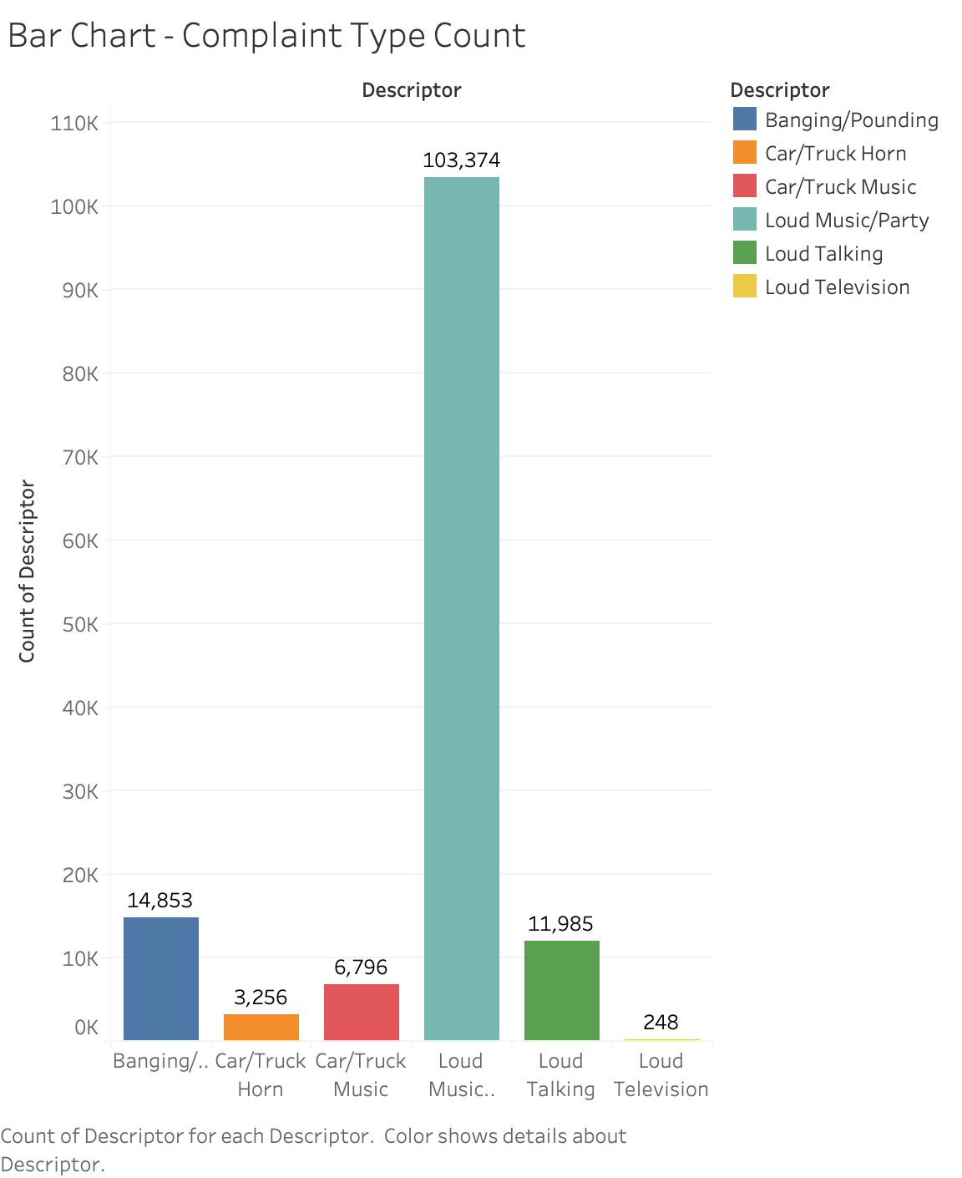
Types of noise documented
Loud music is the most frequent noise descriptor.
Followed by banging/pounding & loud talking.

Slide 6
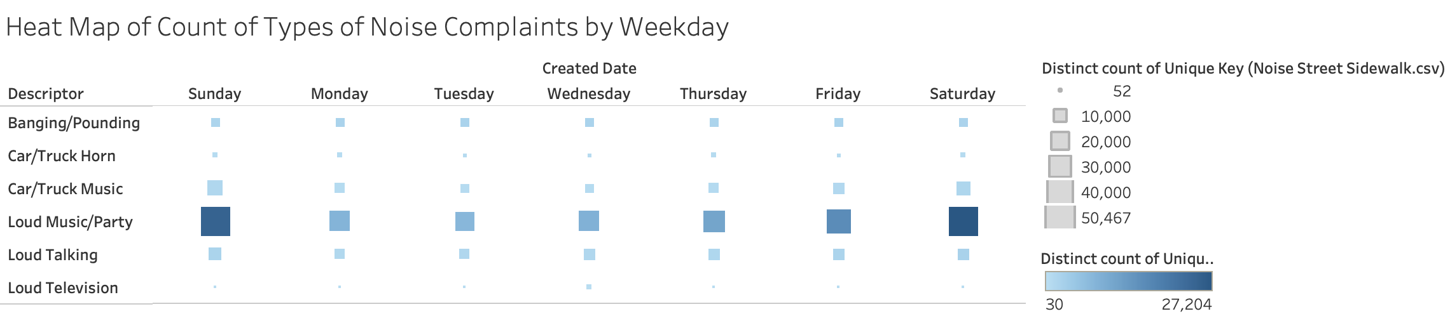
Heat map – Count of calls by weekday

Slide 7
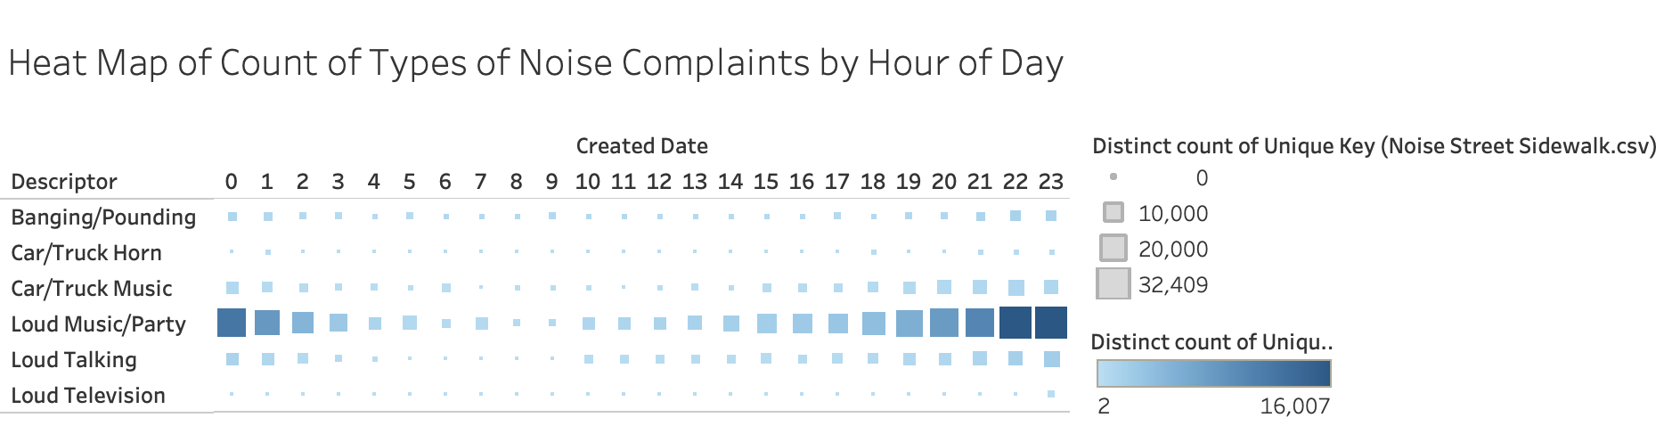
Heat map – Count of calls by hour of day

Slide 8
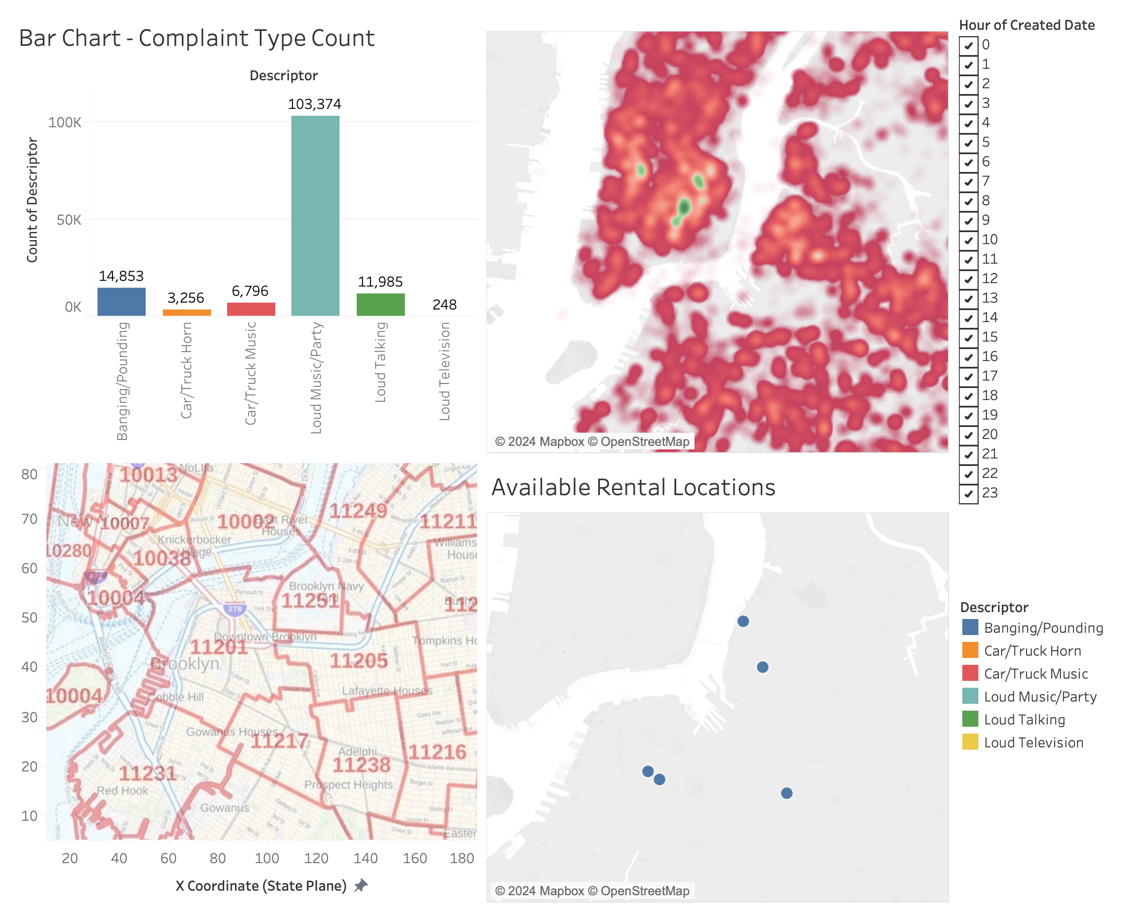
Dashboard on Tableau.
Most frequent noise complaint is loud music/party.
Most noise complaints between 19:00 hours (7p) and 2:00 (2am)
Friday through Sunday are the days of the week that noise complaints have been documented on.

Slide 9
Recommendations
Soundproofing investment that can reduce the sounds of loud music.
Hours of operation should consider that the noise complaints occur most between 7pm through 2am.
Days of operation should consider that weekends tend to have most noise complaints of the week.
11201,11205,11217, and 11238 are most preferable zip codes.

